Slide 1


WEBASSEMBLY DEBUGGING
22. JUNI 2022
9:00 Uhr
Florian Schopp
Full Stack Developer
Notes:
Thema von heute
Wer bin ich?
Warum Webassembly als überleitung

Slide 2






WebAssembly is a binary instruction format for a stack-based virtual machine. Wasm is designed as a portable compilation target for programming languages, enabling deployment on the web for client and server applications.
Browser support:
Applications:
Google Earth
Unity
AutoCAD
https://github.com/emscripten-core/emscripten/wiki/Porting-Examples-and-Demos
Notes:
Entwicklung von Webassembly

Slide 3
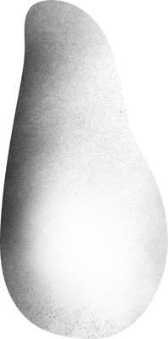
OUR MOTIVATION
To use the same code base as the firmware.
Include parts of the firmware libraries via WebAssembly
Visualization of the effects of user changes on the signal

Slide 4
Notes:
20000 Werte

Slide 5


WEBASSEMBLY
GETTING STARTED
Notes:
Für die gestern nicht anwesenden Leute

Slide 6
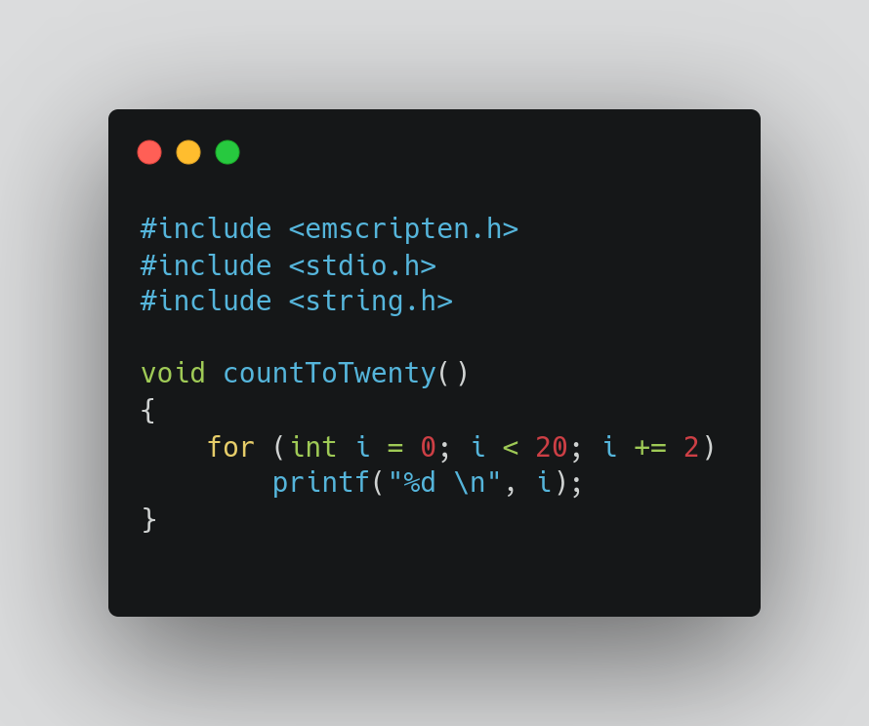
Notes:
Include emscripten

Slide 7



Notes:
Emscripten: Compiler toolchain based on llvm.
Generates pure Webassembly, asm files or complete html files

Slide 9


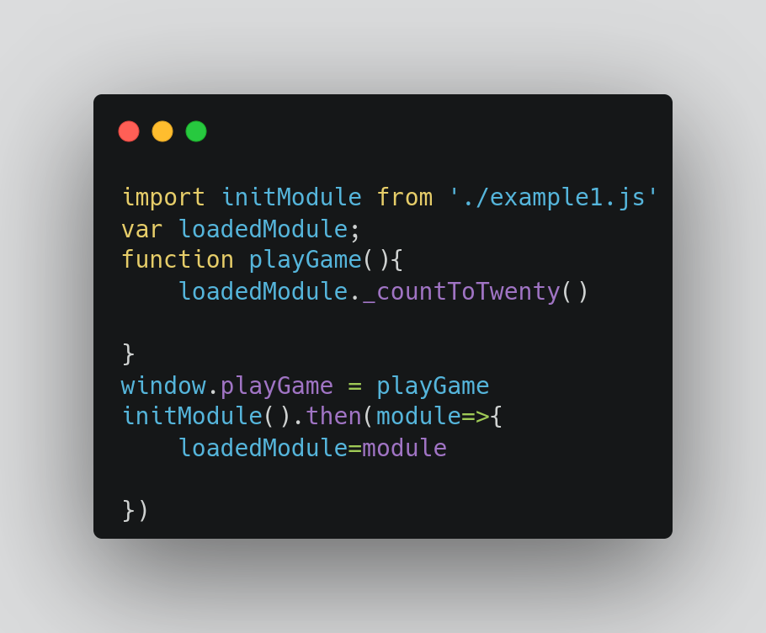
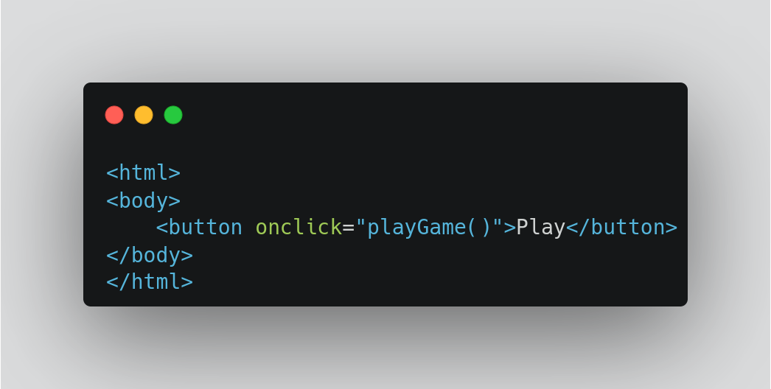

Slide 10
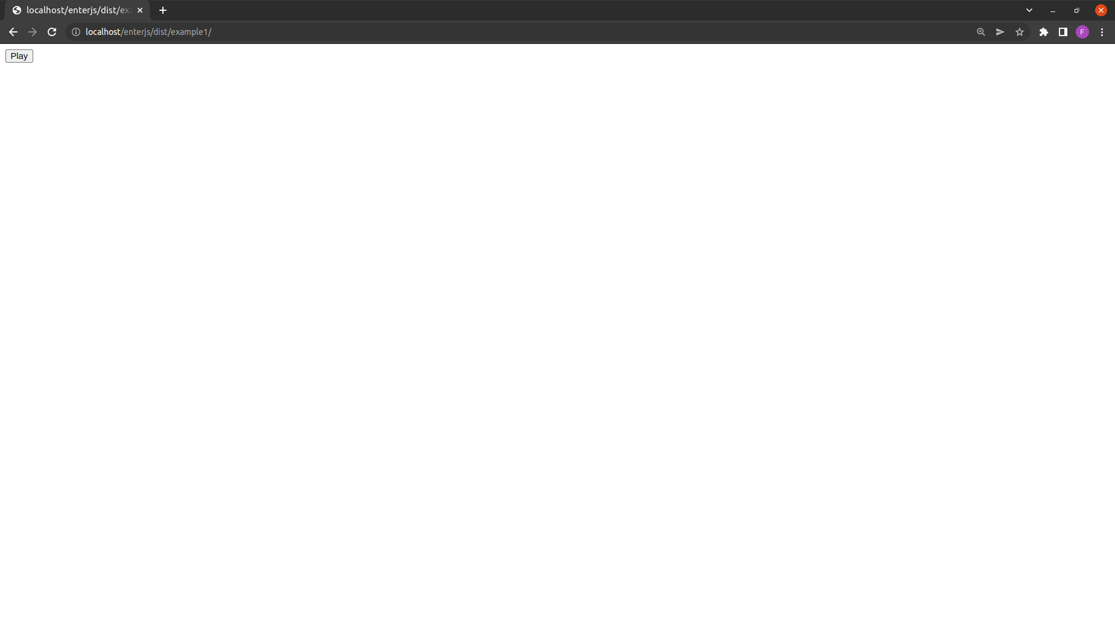

Slide 12
WEBASSEMBLY DEBUGGING

Slide 15



DWARF SUPPORT IN CHROME
Activation
Debug-Console > Settings > Experiments > Enable DWARF support
Install Extension
https://goo.gle/wasm-debugging-extension
Compile with debug information
-g
Notes:
Dwarf erklären
Support in Chrome seit ende 2019

Slide 18
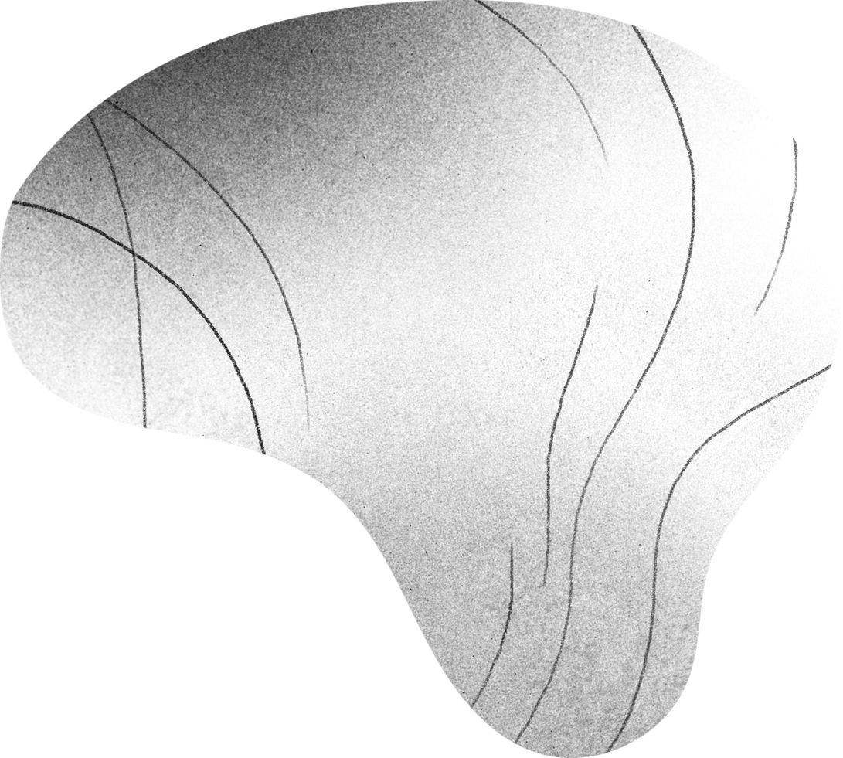
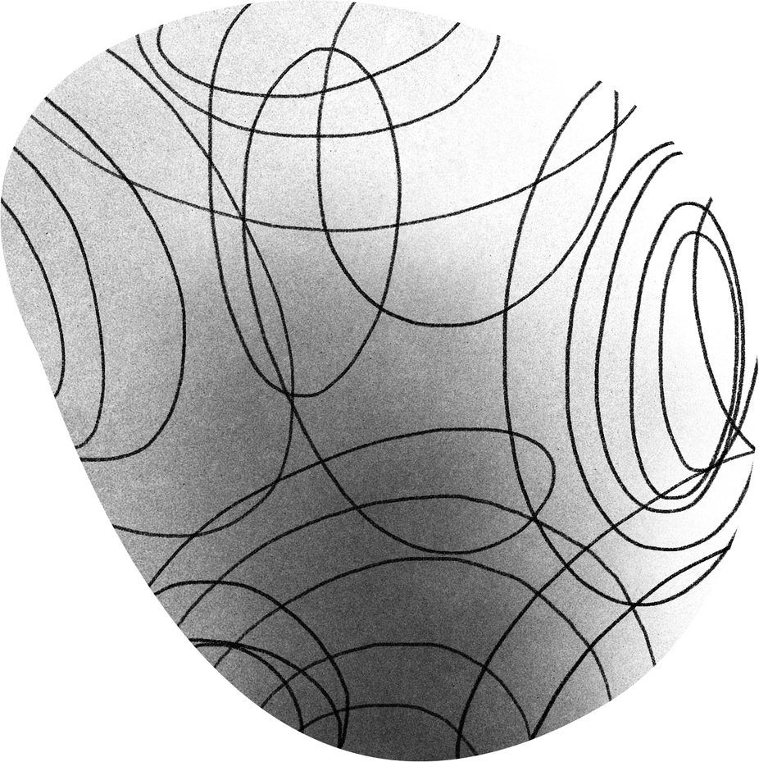
Enterjs game
Print Game Started
for 1 to 20
If the number is dividable by 3 and 5 print enterJS
If the number is dividable by 3 print enter
If the number is dividable by 5 print JS
Else print Cannot be devided by 3 or 5
Print Game Ended

Slide 19
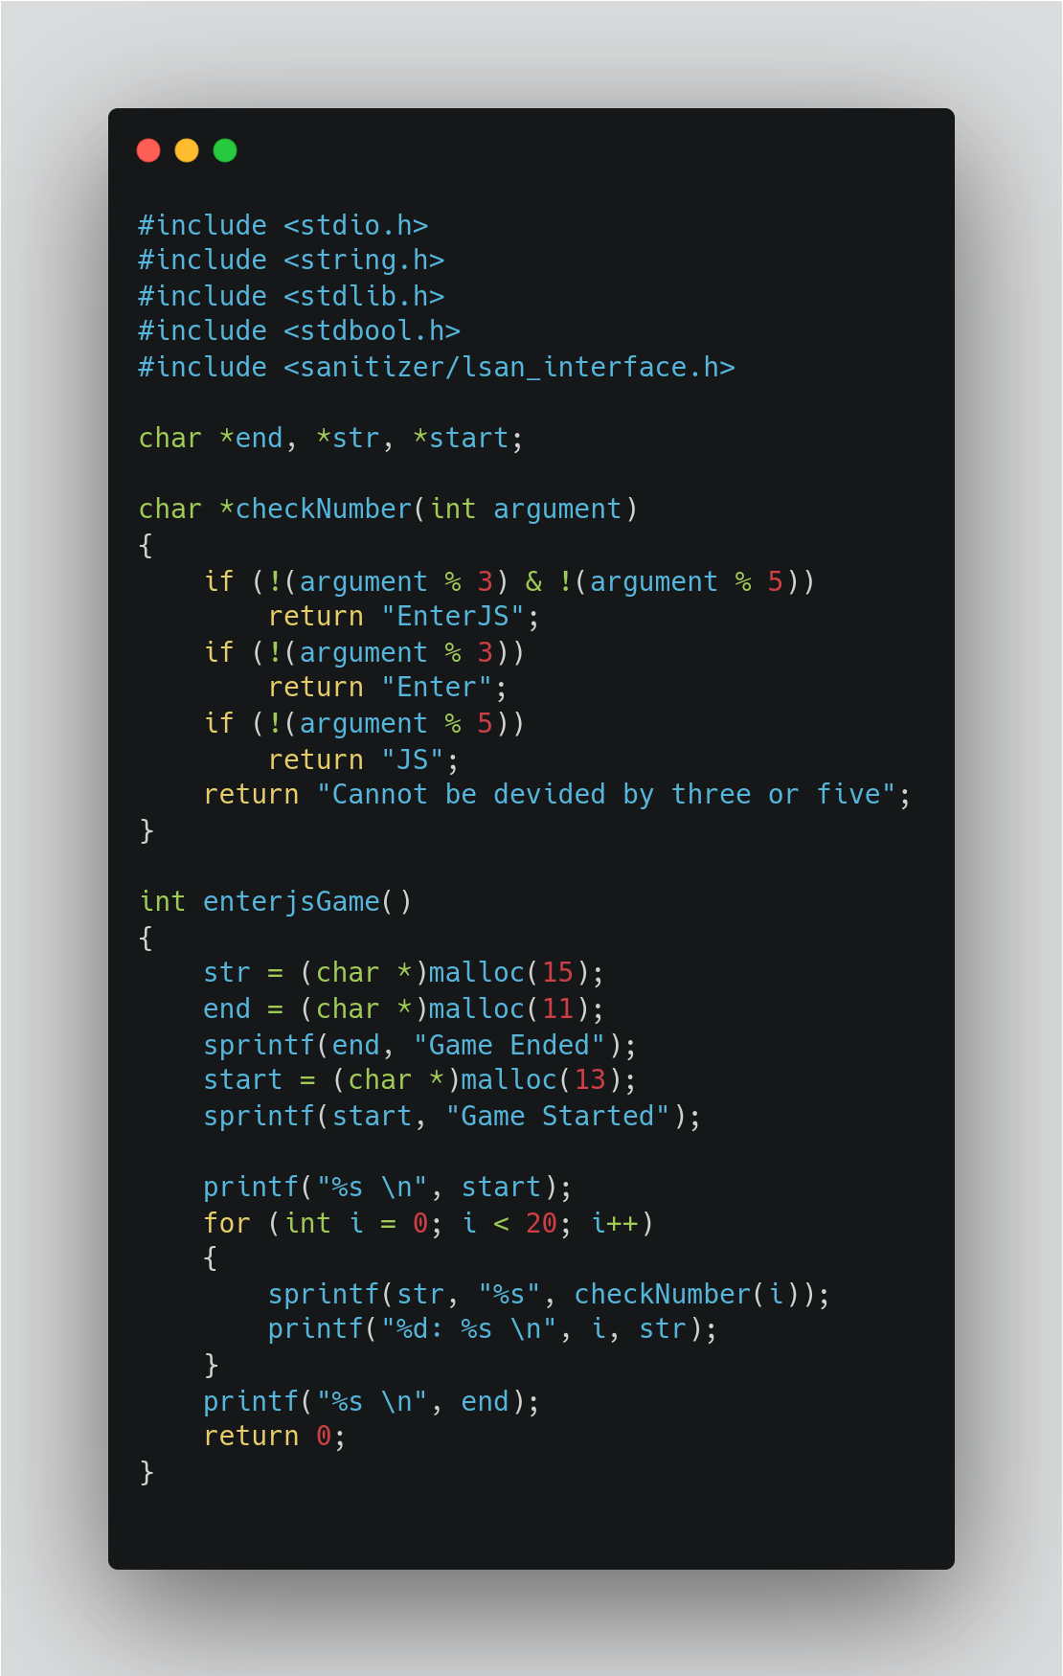

Slide 22
SANITIZERS
Purpose
Track the execution at runtime to report execution errors
Types
AddressSanitizer and LeakSanitizer
ThreadSanitizer
MemorySanitizer
Compile with debug information
- fsanitize=address
Notes:
Sanitizers genauer erklären
Zweck und formen

Slide 24
Notes:
Weitere Folien zum erklären was ich falsch emacht habe
Andere anwendungsfälle:
Memory die nicht wieder freigegeben wird oder falsche pointer, usage after free usw

Slide 26
Our case
Overlapping memory areas. Program used pointers that pointed into program stack.
Memory was not freed after usage. Growing memory problem.
Pointer to uninitialized memory areas

Slide 27
STANDALONE EXECUTION
Execution of Webassembly Modules outside of the browser

Slide 28
INSTALLATION
Wasm SDK
containing compatible clang package and sysroot
https://github.com/WebAssembly/wasi-sdk
Wasmtime
Standalone Runtime environment for webassembly
https://github.com/bytecodealliance/wasmtime

Slide 29
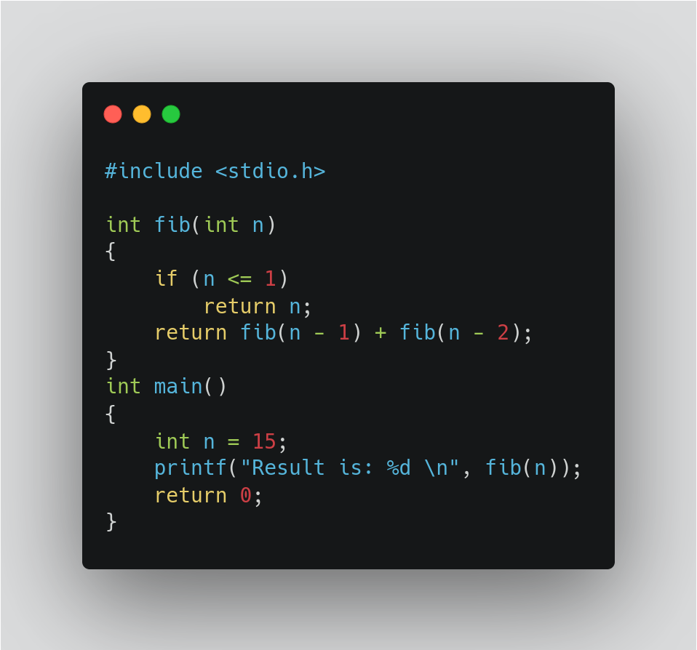

Slide 31
WASMTIME
The result is: 610

Slide 32
Attach to process using lldb
Notes:
Andere editoren -- grafische oberfläche wäre möglich

Slide 33
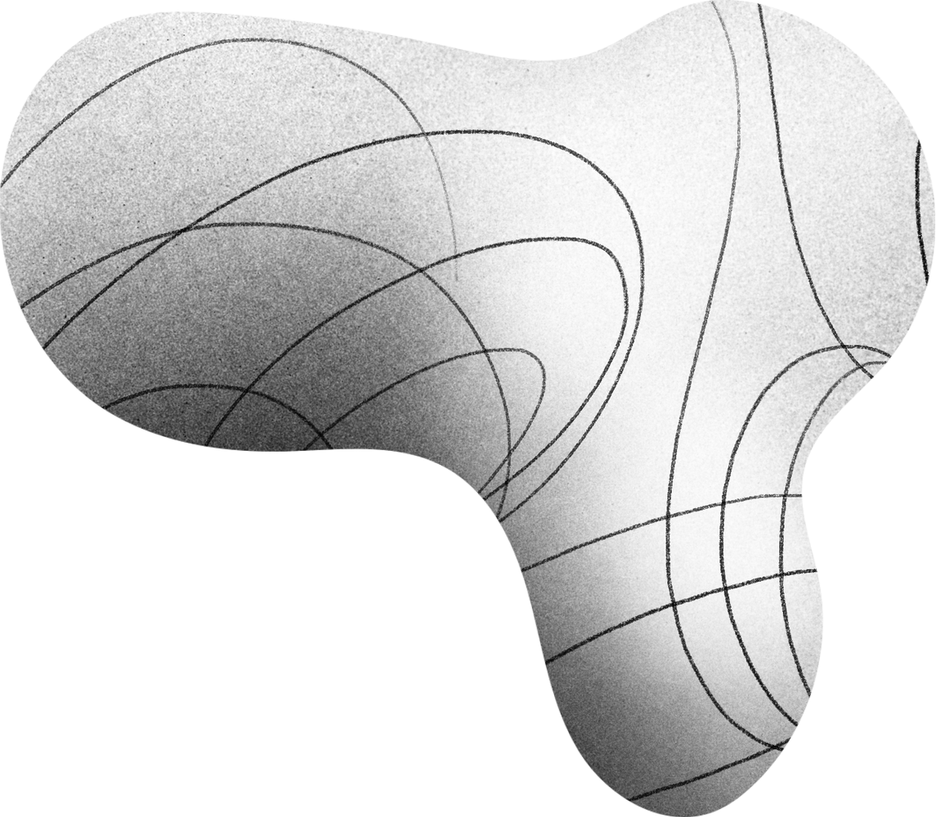
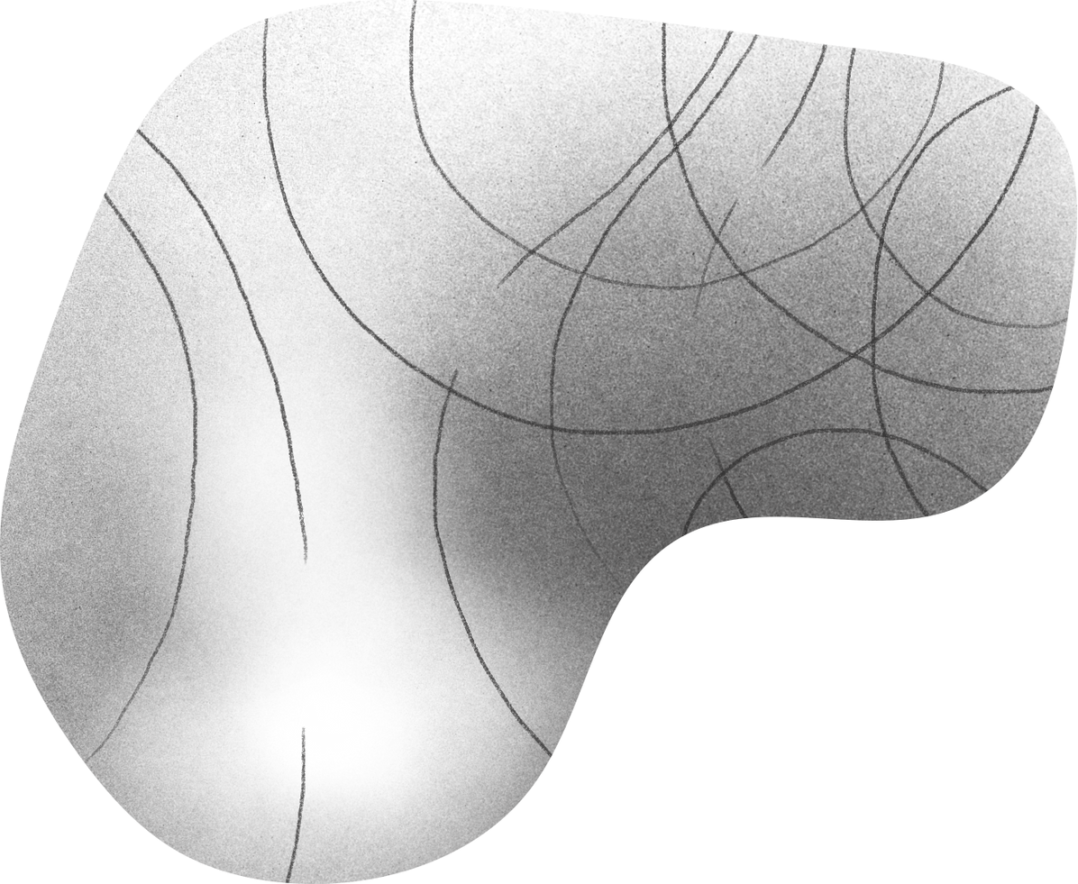
VS CODE INTEGRATION

Slide 34
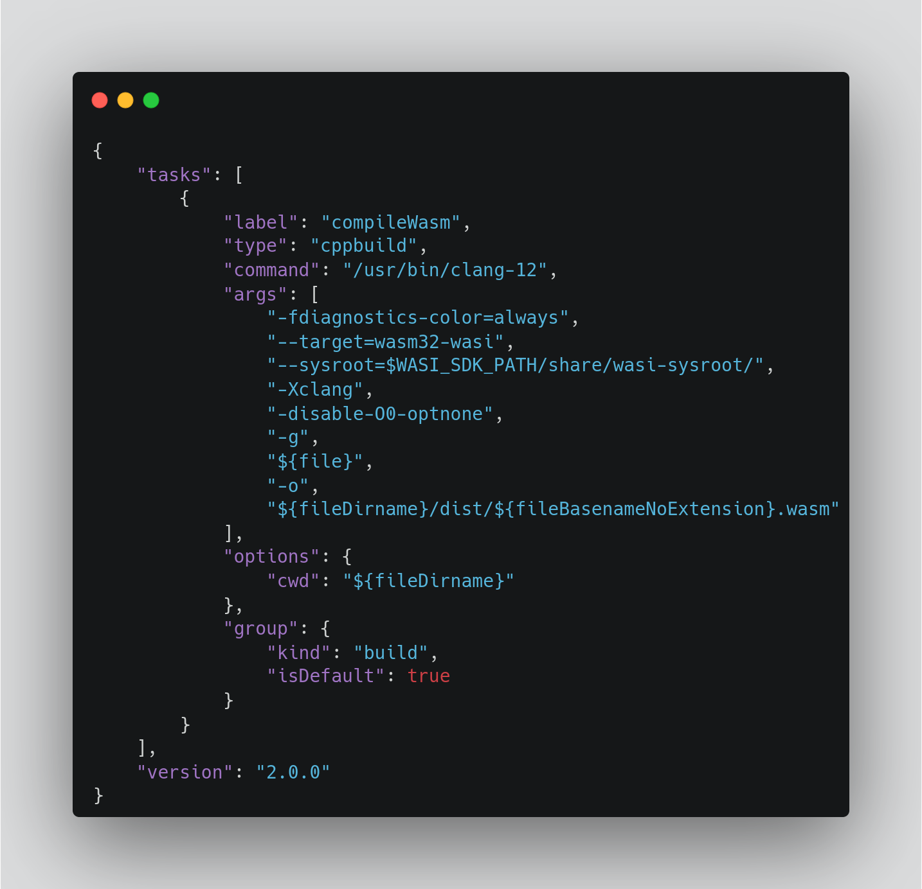

Slide 35
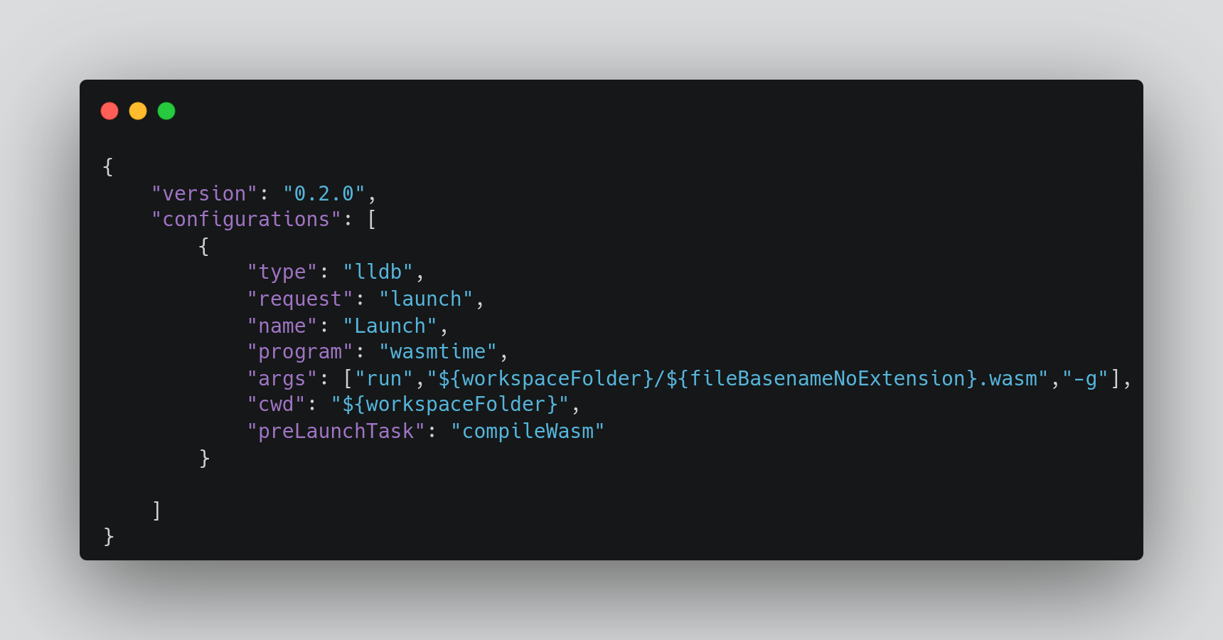

Slide 37
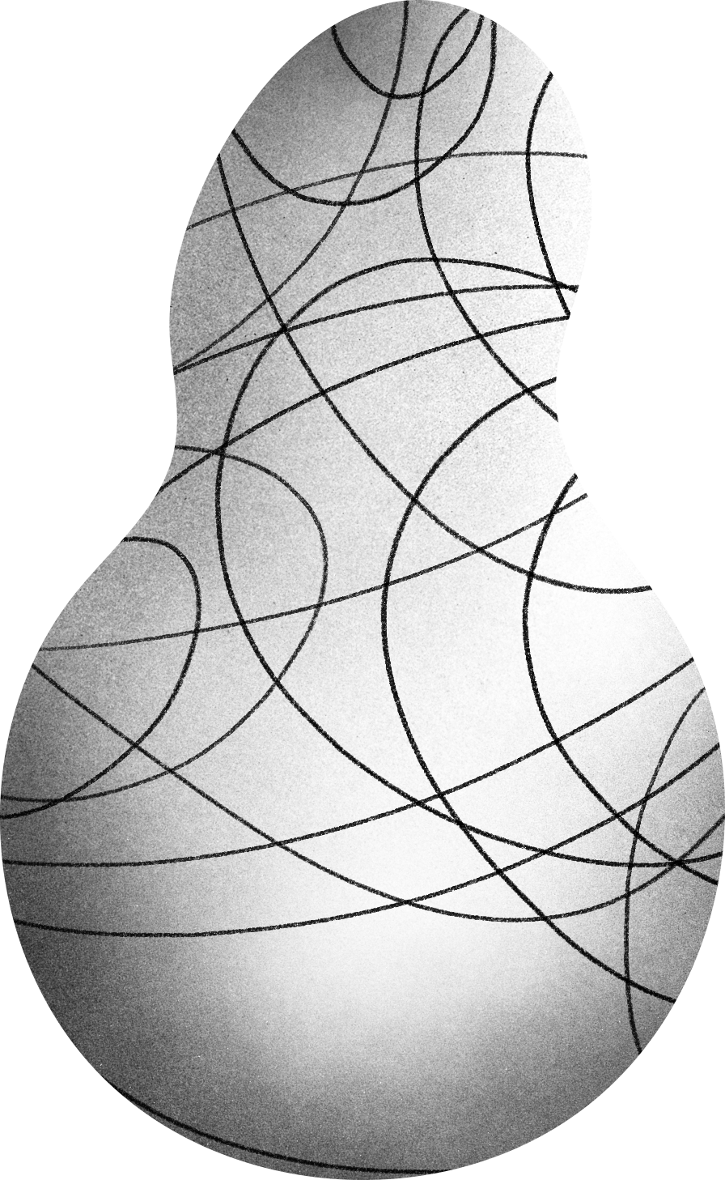

THANK YOU

